Slide 1

Apply or Not
To apply or not – that is the question.
Built for OpenAI Build Week

Slide 2

Notes:
Over the past several years, I have worked on exciting projects. Learned a lot of things.

Slide 3

Notes:
As a next step in my career, I decided to move to Germany to evolve as an engineer, take on more challenges, and work on products at an even larger scale.

Slide 4
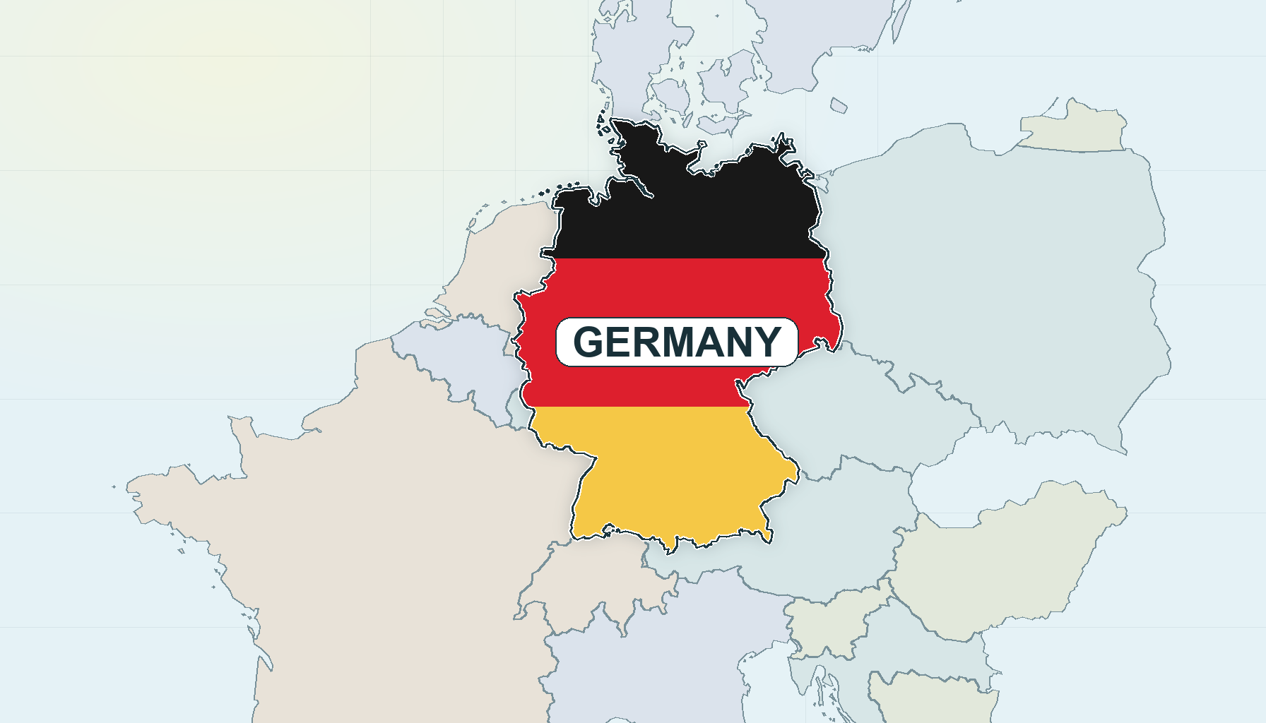
Notes:
I consider Germany a great place for my career growth, and I was really happy to be settling here.

Slide 5

Fluent in both German and English
Sehr gute Deutsch- und gute Englischkenntnisse in Wort und Schrift
Professional fluency in English
Notes:
But I often encountered several challenges when applying for jobs in the German job market. My German language skills weren’t adequate. I needed to translate part of the page by selecting text. Sometimes there was a strict German language requirement; sometimes not. I wanted to speed things up. If only there was a way…

Slide 6

Notes:
But I often encountered several challenges when applying for jobs in the German job market. My German language skills weren’t adequate. I needed to translate part of the page by selecting text. Sometimes there was a strict German language requirement; sometimes not. I wanted to speed things up. If only there was a way…

